Slide 1
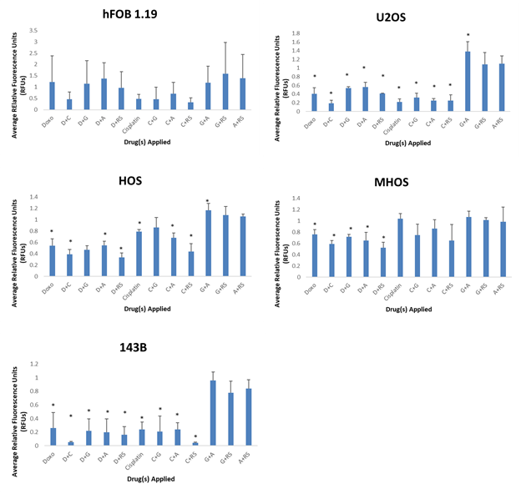
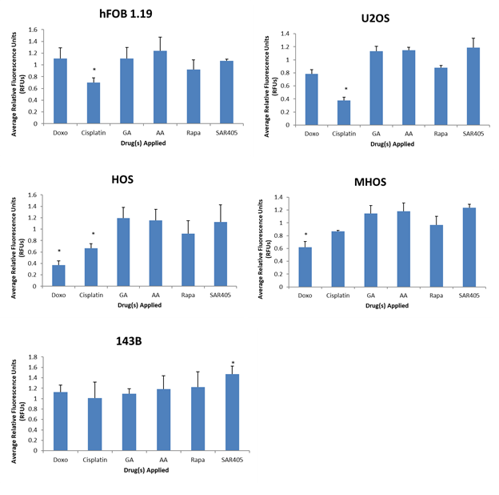
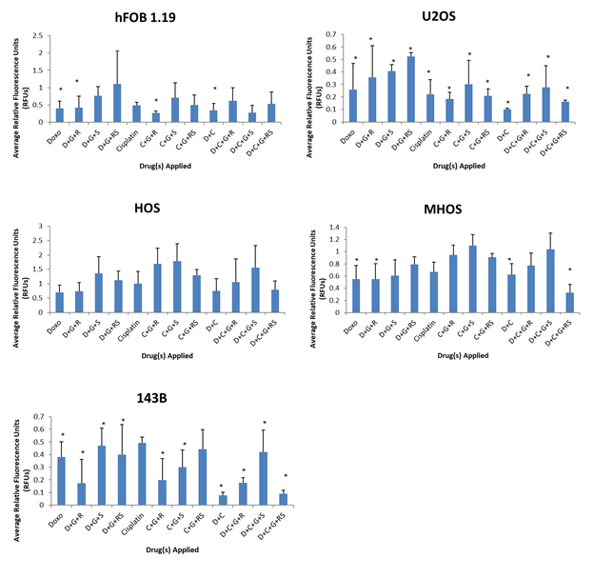
The Effects of Anti-Sumoylation Drugs in Inhibiting Osteosarcoma Cell Expansion
Leah Thompson, Dr. Tao Yang, Di Lu, Van Andel Research Institute, Grand Rapids, Michigan
Background
Methods
Double Treatment
Conclusions
Osteosarcoma (OS) is the most common form of primary bone cancer with tumorigenic and metastatic characteristics.
The overactive sumoylation pathway in OS facilitates OS development in mice.
Current chemotherapy treatments are showing difficulty in effectively targeting and killing OS in humans.
We hypothesized that inhibiting the sumoylation process can facilitate OS treatment.
The cell lines (hFOB 1.19, U2OS, HOS, MHOS, and 143B) were prepared for either a single, double, or multiple combination treatment and seeded overnight.
Figure 2. Average Relative Fluorescence Units (RFUs) for Double Treatment of Human Osteoblast and Osteosarcoma Cells. The control group was used as the standard at 1 RFUs. * = statistically significant, p-value < 0.05
Combinations of interest for the double treatment included doxorubicin with cisplatin, doxorubicin with rapamycin and SAR405, and cisplatin with rapamycin and SAR405.
The multiple combination treatment had interesting combinations including doxorubicin with GA and rapamycin, cisplatin with GA and rapamycin, and doxorubicin with cisplatin, GA, rapamycin, and SAR405.
Combinations of future interest include doxorubicin/cisplatin with rapamycin, doxorubicin/cisplatin with SAR405, and doxorubicin with cisplatin, rapamycin, and SAR405.
Determining the effects of anti-sumoylation drugs in inhibiting OS cell expansion could provide a new and novel therapeutic treatment for targeting and killing OS in patients.
Various combinations of genotoxic doxorubicin and cisplatin, sumoylation inhibitors GA and AA, mTOR inhibitor rapamycin, and autophagy inhibitor SAR405 were added to the cells and left for 48 hours.
Abstract
Osteosarcoma is the most common form of primary bone cancer with tumorigenic and metastatic characteristics with an overactive sumoylation pathway. However, over the past 30+ years, it has been challenging to improve osteosarcoma treatment and to develop a standard therapy. Little research has been conducted on the inhibition of osteosarcoma cell expansion via the sumoylation pathway; as few as three published papers discuss inhibiting various components of the sumoylation pathway and its effects on osteosarcoma. It was hypothesized that if the sumoylation process is inhibited, then osteosarcoma treatment using current chemotherapy drugs can be facilitated. The cell lines hFOB 1.19 (human osteoblast), U2OS (p53 WT OS), HOS (non-tumorigenic OS), MHOS (tumorigenic OS), and 143B (tumorigenic and metastatic OS) were used to observe the effects of applying anti-sumoylation drugs Ginkgolic Acid (GA) and Anacardic Acid (AA) in combination with doxorubicin and cisplatin, two current osteosarcoma chemotherapy drugs. Rapamycin, an mTOR inhibitor, and SAR405, an autophagy inhibitor, were also applied in combination with the aforementioned drugs for single, double, and multiple combination treatments. Cell expansion was determined by measuring the average relative fluorescence with the CyQUANT Cell Proliferation Assay; a t-test was conducted for each treatment applied to all five cell lines. The most effective combinations across the cell lines from the double treatment included doxorubicin/cisplatin with rapamycin and SAR405, and doxorubicin with cisplatin while the best combinations for the multiple treatment included doxorubicin/cisplatin with GA and rapamycin, and doxorubicin with cisplatin, GA, rapamycin, and SAR405. These combinations’ p-values were less than 0.05 thus leading to the inference that these combinations had a significant impact on osteosarcoma cell expansion. By researching the effects of new combination therapies on osteosarcoma, a better understanding and treatment can be developed for osteosarcoma. Sumoylation inhibitors can aid in the knowledge acquisition and improvement of treatment for osteosarcoma.
A CyQUANT Cell Proliferation Assay was used to determine cell expansion.
Single Treatment
Triple Treatment
Acknowledgments
Figure 1. Average Relative Fluorescence Units (RFUs) for Single Treatment of Human Osteoblast and Osteosarcoma Cells. The control group was used as the standard at 1 RFUs. * = statistically significant, p-value < 0.05
Figure 3. Average Relative Fluorescence Units (RFUs) for Multiple Combination Treatment of Human Osteoblast and Osteosarcoma Cells. The control group was used as the standard at 1 RFUs. * = statistically significant, p-value < 0.05
I would like to thank all members of the Yang laboratory, specifically Dr. Tao Yang and Di Lu who mentored my project. I would also like to thank the Frederik and Lena Meijer Student Internship Program for funding my internship, as well as Van Andel Research Institute for providing me with the opportunity to conduct research at their Institute.
Notes:
Mini-Spheel
Background:
Wanted to
We hypothesized that
Methods:
Conclusions:
Impact:

